Slide 1
Economics Module
Lecture 3

Slide 2
Reading
Rohit Lamba and Arvind Subramanian (2020) Dynamism with Incommensurate Development: The Distinctive Indian Model
Journal of Economic Perspectives

Slide 3
An introduction to the Indian economy
At independence, India was a poor country with little investable resources or infrastructure for rapid growth
Moreover, it was a territory with exceptional heterogeneity in terms of various identities ( language, caste, religion, ethnicity ..)
Most economic and social indicators were at extremely low level (around 1947)
- Per capita income 820 USD ( 2011 PPP dollars)
- more than 70 percent of the population below poverty line
- Child mortality rate 30 percent
- Life expectancy at birth 32 years

Slide 4
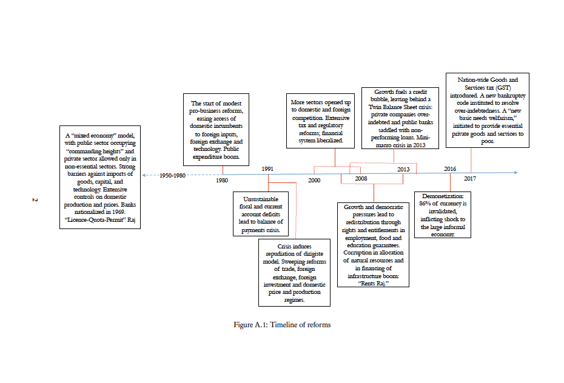
The broad trajectory of economic policymaking

Slide 5
Main accomplishments of Indian development in past seven decades
One of the few developing countries which has maintained a moderate growth rate throughout its post-independent history
Growth clearly accelerated with the advent of market oriented economic reforms. The benefits of growth however was not evenly distributed
Indian per capita income more than 6500 USD ( in 2011 PPP dollars)
Poverty rate less than 20 percent ( although reliable estimate for the last 10 years is not available)
Significant improvement in various indices of social development ( health, education etc.)

Slide 6
Digging deeper into the Indian economic evolution
Democratization before development (see next slide)
Here we are really talking about electoral democracy
What does universal electoral rights imply for the pace and nature of development?
Does such democratic entitlement slow down the potential of rapid growth and development?
Not really but why

Slide 7
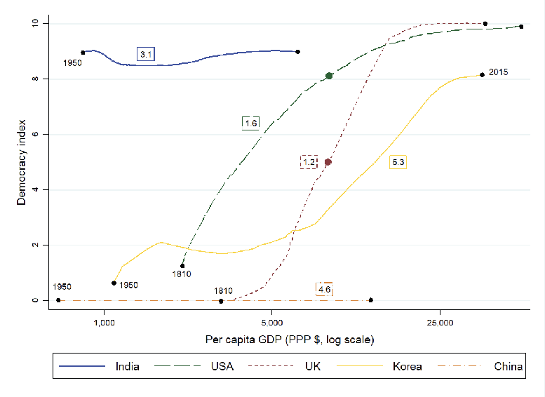
Evolution of electoral democracy and economic development

Slide 8
The imperfect nature of sectoral change
Historically, every country that has developed, went though a process of structural change that involved a gradual reallocation of the share of employment and GDP from agriculture to manufacturing and eventually services ( structural transformation as we have discussed)
In case of India the nature of this change has been atypical
The manufacturing sector which has the highest capacity to provide good quality jobs has had a stunted growth in India
Services has been the dominant sector ( servicification of the economy) with associated problems: a dynamic part with little employment and a huge informal part with low returns

Slide 9
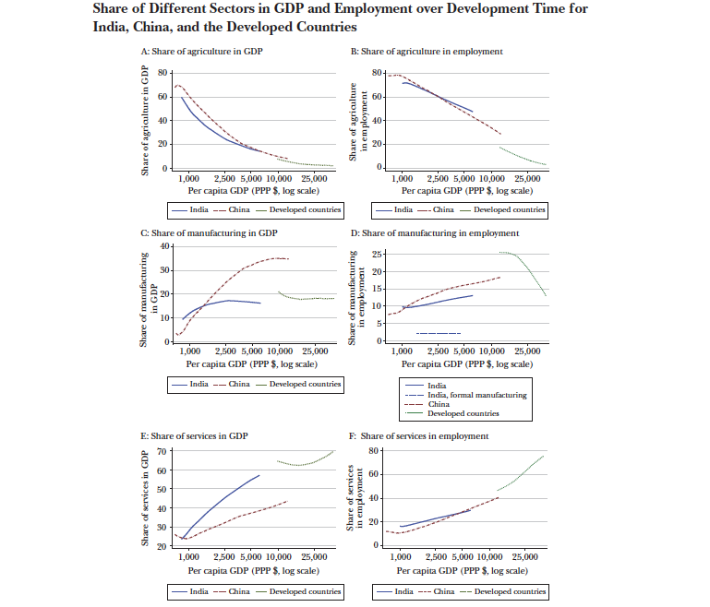

Slide 10
The nodes of inequality and exclusion in the growth process
Spatial inequality: urban vs rural, high growth states vs. low growth states
Exclusion based on caste and religion and ethnicity( see next slide)
The gender dimension: sex selection at birth and educational constraints of the girl child, labour market discrimination
The gaps in environmental sustainability: urban pollution, ground water depletion, rampant use of chemical fertilizers and insecticides in agriculture

Slide 11
